Slide 1
A CUDA Implementation of the HPCG Benchmark
Everett Phillips
Massimiliano Fatica

Slide 2
outline
High Performance Conjugate Gradient Benchmark
Introduction
CUDA Implementation
Optimization
Performance Results
Single GPU
GPU Supercomputers
Conclusion

Slide 3
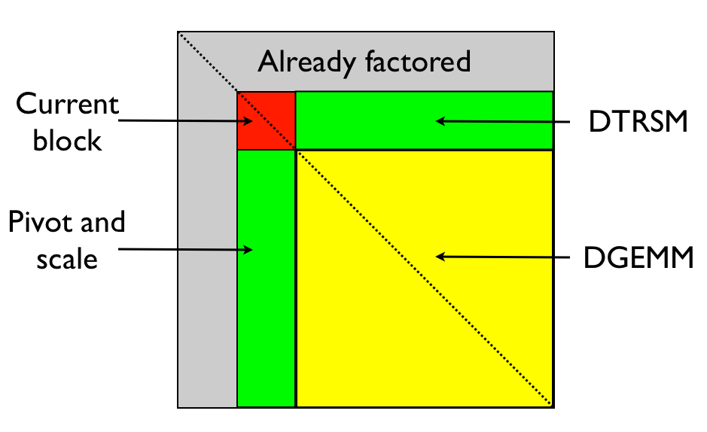
Why HPCG ?
HPL (Linpack) Top500 benchmark
Supercomputer Ranking / Evaluation
Dense Linear Algebra (Ax = b)
Compute intensive
DGEMM (Matrix-Matrix Multiply)
O(N3)FLOPS / O(N2) Data
10-100 Flop/Byte
Workload does not correlate with many modern applications

Slide 4
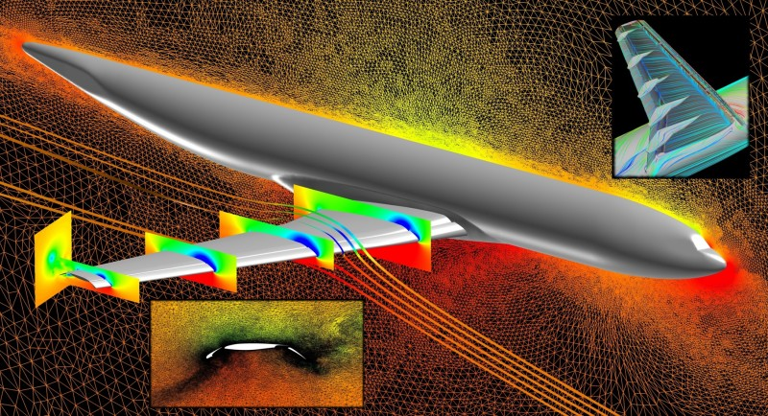
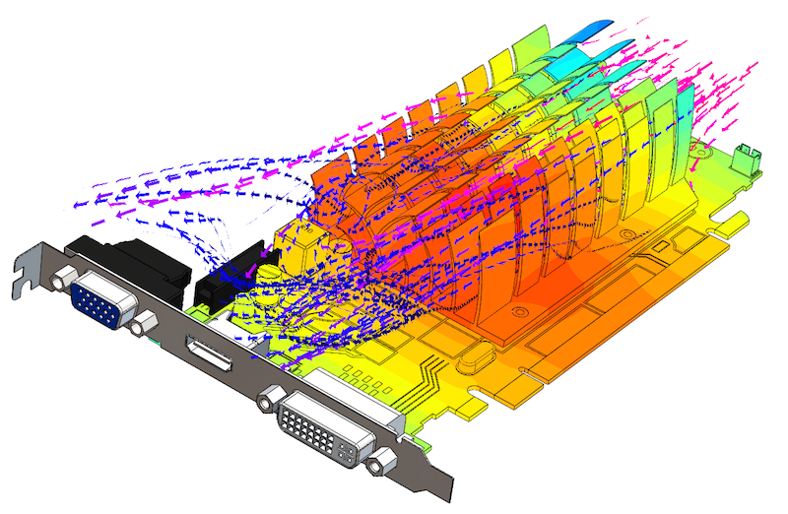
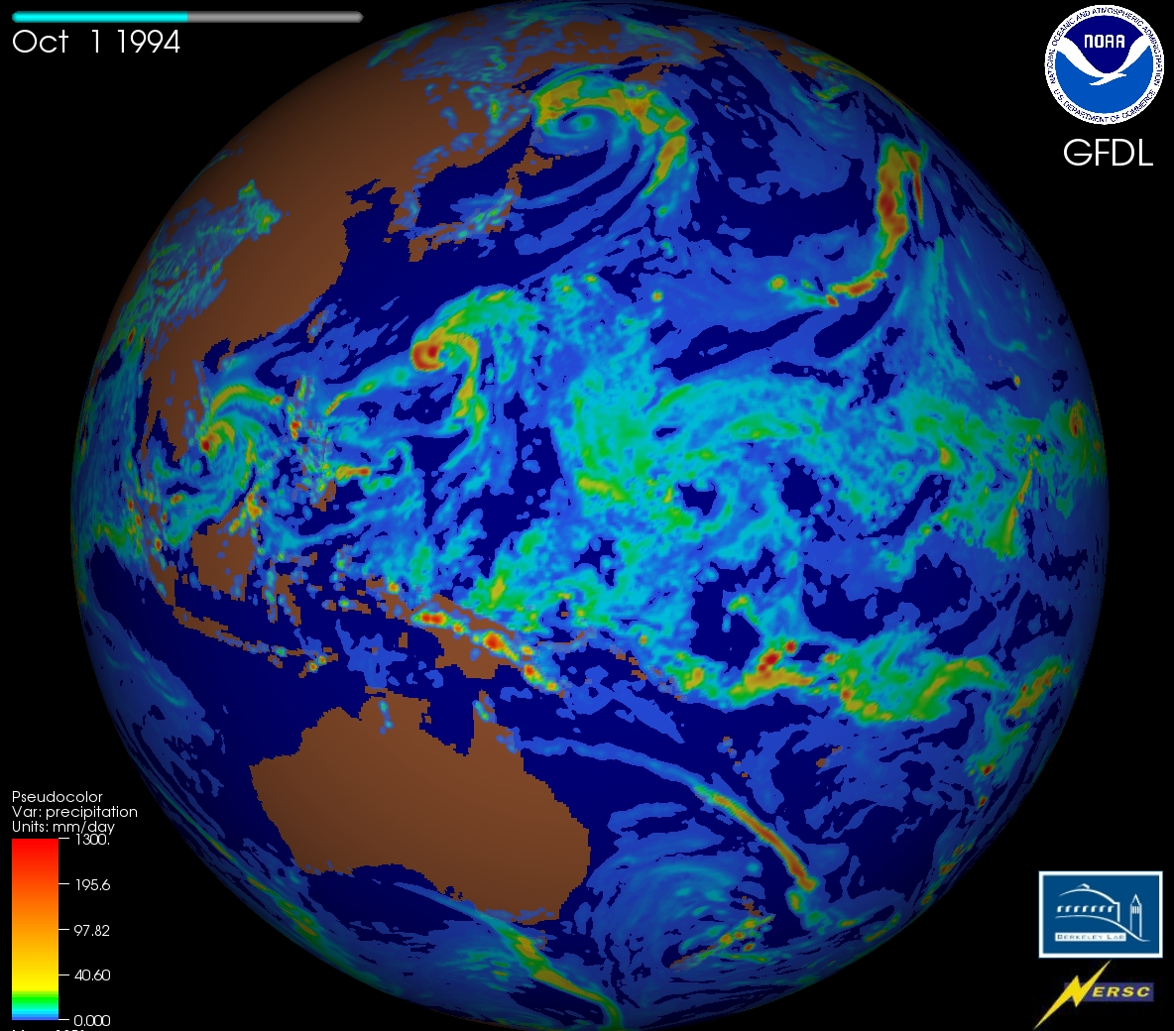
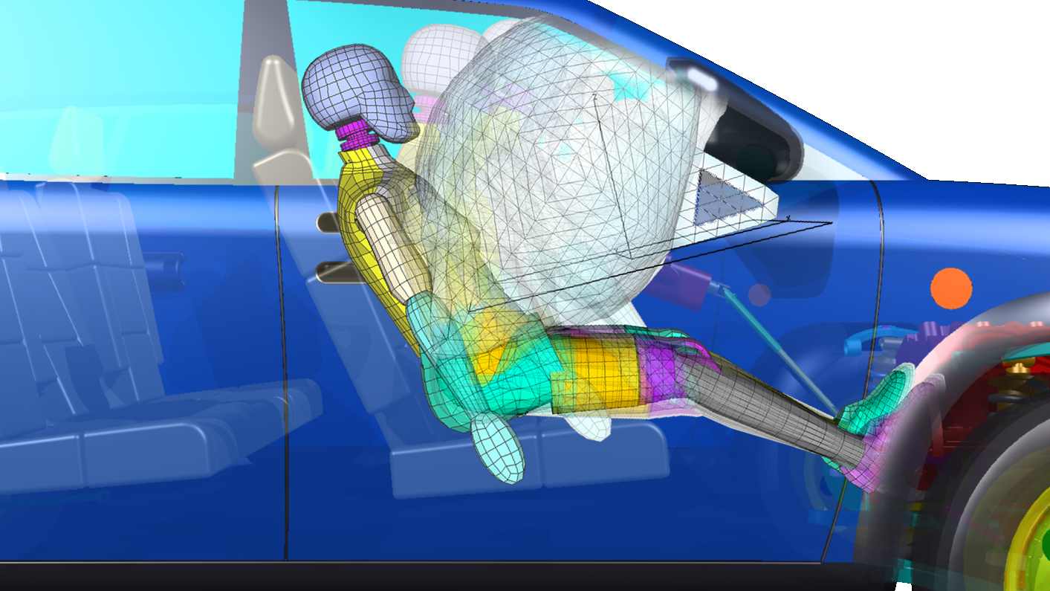

Why HPCG?
New Benchmark to Supplement HPL
Common Computation Patterns not addressed by HPL
Numerical Solution of PDEs
Memory Intensive
Network

Slide 5
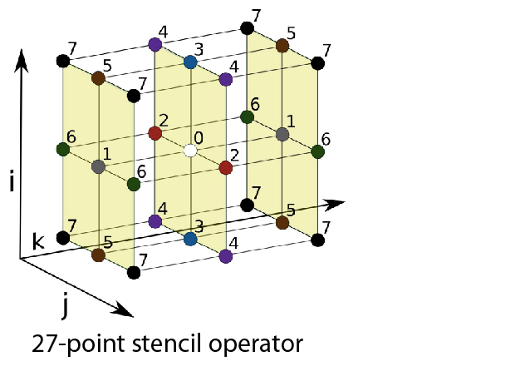
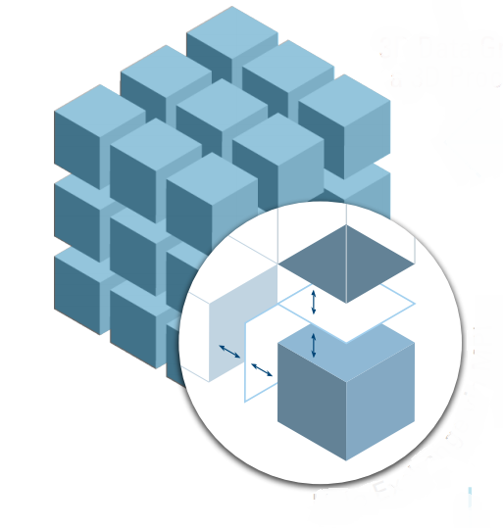
HPCG Benchmark
Preconditioned Conjugate Gradient Algorithm
Sparse Linear Algebra (Ax = b), Iterative solver
Bandwidth Intensive: 1/6 Flop/Byte
Simple Problem (sparsity pattern of Matrix A)
Simplifies matrix generation/solution validation
Regular 3D grid, 27-point stencil
Nx x Ny x Nz local domain / Px x Py x Pz Processors
Communications: boundary + global reduction

Slide 6
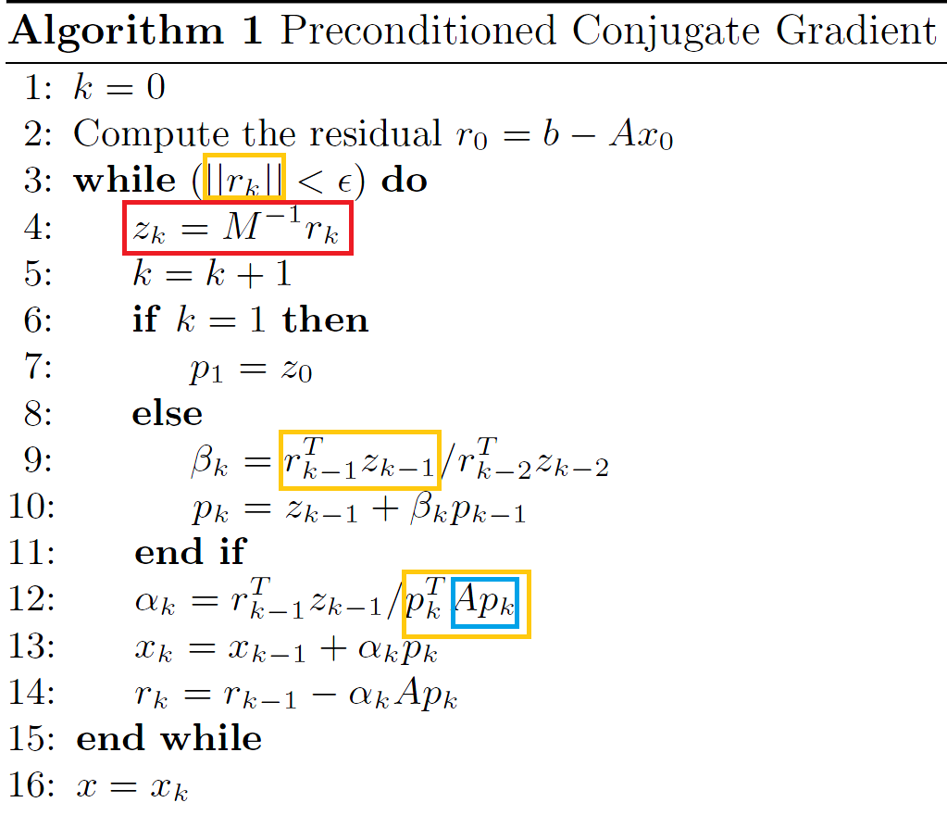
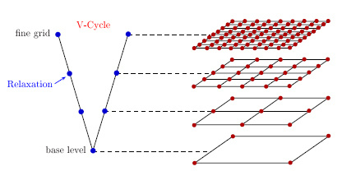
HPCG ALGORITHM
Multi-Grid Preconditioner
Symmetric-Gauss-Seidel Smoother (SYMGS)
Sparse Matrix Vector Multiply (SPMV)
Dot Product – MPI_Allreduce()

Slide 7
HPCG BENCHMARK
Problem Setup – initialize data structures
Optimization (required to expose parallelism in SYMGS smoother)
Matrix analysis / reordering / data layout
Time counted against final performance result
Reference Run – 50 iterations with reference code – Record Residual
Optimized Run – converge to Reference Residual
Matrix re-ordering slows convergence (55-60 iterations)
Additional iterations counted against final performance result
Repeat to fill target execution time (few minutes typical, 1 hour for official run )

Slide 8
HPCG
SPMV (y = Ax)
Exchange_Halo(x) //neighbor communications
for row = 0 to nrows
sum ← 0
for j = 0 to nonzeros_in_row[ row ]
col ← A_col[ j ]
val ← A_val[ j ]
sum ← sum + val * x[ col ]
y[ row ] ← sum
No dependencies between rows, safe to process rows in parallel

Slide 9
HPCG
SYMGS (Ax = y, smooth x)
Exchange_Halo(x) //neighbor communications
for row = 0 to nrows (Fwd Sweep, then Backward Sweep for row = nrows to 0)
sum ← b[ row ]
for j = 0 to nonzeros_in_row[ row ]
col ← A_col[ j ]
val ← A_val[ j ]
if( col != row ) sum ← sum – val * x[ col ]
x[ row ] ← sum / A_diag[ row ]
if col < row, must wait for x[col] to be updated

Slide 10
CUDA IMPLEMENTATIONS
Cusparse CSR
Cusparse CSR + Matrix Reordering
Custom Kernels CSR + Matrix Reordering
Custom Kernels ELL + Matrix Reordering

Slide 11
BASELINE Cusparse
Leverage existing Libraries
CUSPARSE (TRSV + SPMV), CUBLAS (DOT, AXPY), THRUST (sort, count)
Flexible, works with any matrix ordering (allows experimentation)
Shortcomings
Triangular solve perf (limited parallelism, memory access pattern)
Expensive Analysis for Triangular Solves
Extra steps to compute SYMGS ( SPMV + Vector Update)
Columns must be sorted WRT diagonal

Slide 12
OptimizED versions
Reorder Matrix (Graph Coloring)
triangular solve perf
Custom Kernels
Removes extra steps in SYMGS (same algorithm as reference)
No cusparse analysis overhead
Relaxed data format requirements (non square mtx and unsorted columns ok)
ELLPACK
Memory access efficiency

Slide 13
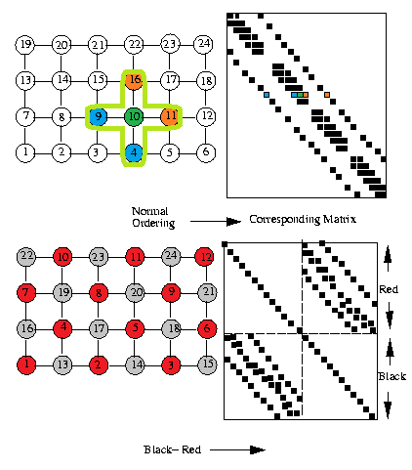

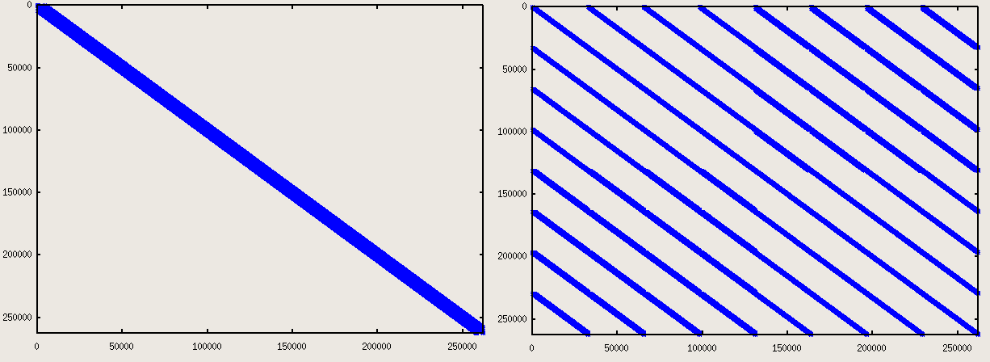
Matrix Reordering (Coloring)
SYMGS - order requirement
Previous rows must have new value
reorder by color (independent rows)
2D example: 5-point stencil -> red-black
3D 27-point stencil = 8 colors

Slide 14
Matrix Reordering (coloring)
Coloring to extract parallelism
Assignment of “color” (integer) to vertices (rows), with no two adjacent vertices the same color
“Efficient Graph Matching and Coloring on the GPU” – (Jon Cohen)
Luby / Jones-Plassman based algorithm
Compare hash of row index with neighbors
Assign color if local extrema
Optional: recolor to reduce # of colors

Slide 15
More Optimizations
Overlap Computation with neighbor communication
Overlap 1/3 MPI_Allreduce with Computation
__LDG loads for irregular access patterns (SPMV + SYMGS)

Slide 16
Optimizations
SPMV Overlap Computation with communications
Gather to GPU send_buffer Copy send_buffer to CPU MPI_send / MPI_recv Copy recv_buffer to GPU Launch SPMV Kernel
GPU
CPU
Time

Slide 17
Optimizations
SPMV Overlap Computation with communications
Gather to GPU send_buffer Copy send_buffer to CPU Launch SPMV interior Kernel MPI_send / MPI_recv Copy recv_buffer to GPU Launch SPMV boundary Kernel
GPU Stream A
GPU Stream B
CPU
Time

Slide 18
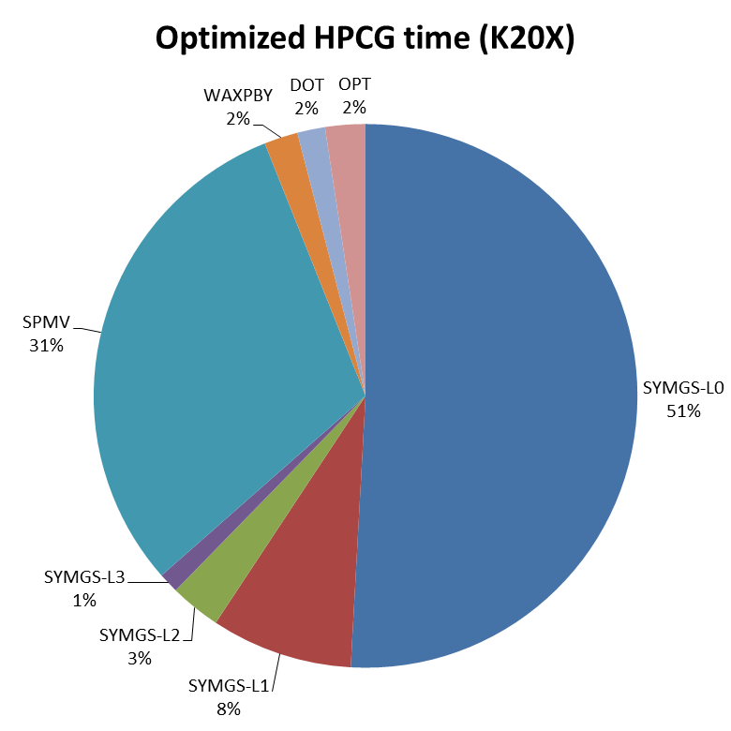
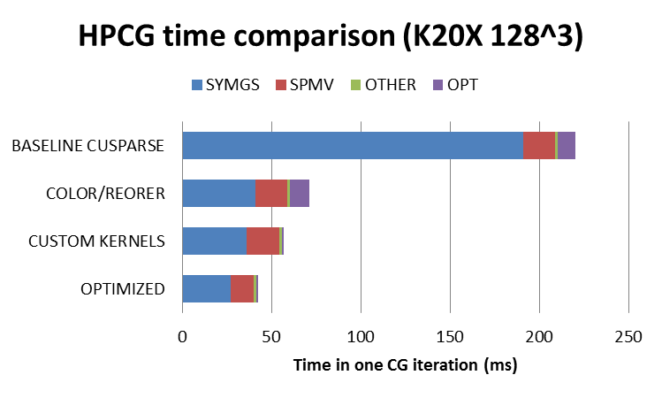
RESULTS – Single GPU

Slide 19
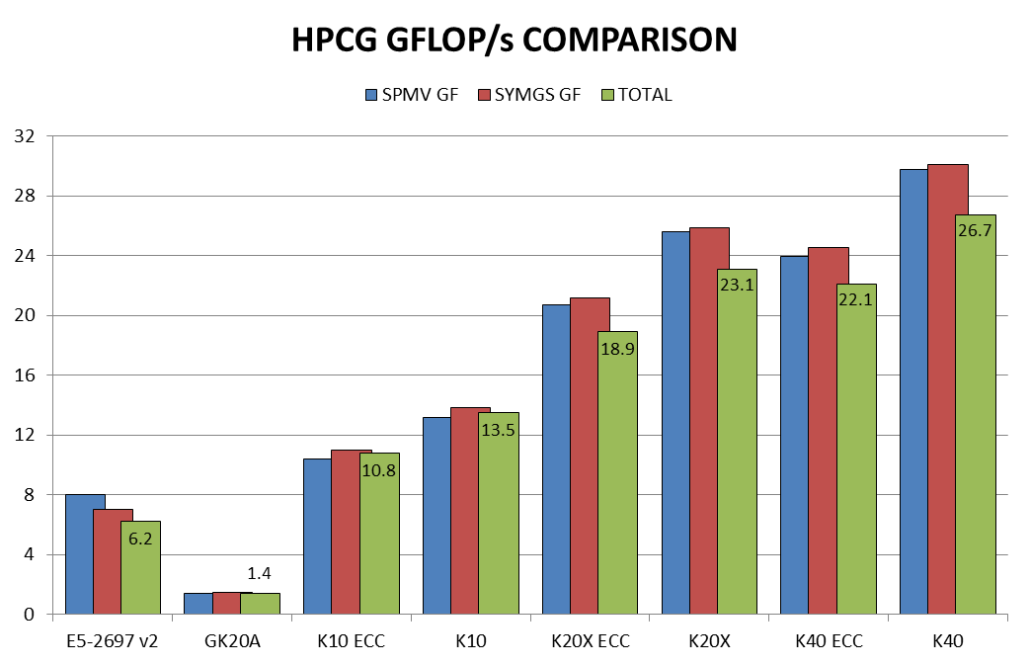
RESULTS – SINGLE GPU

Slide 20
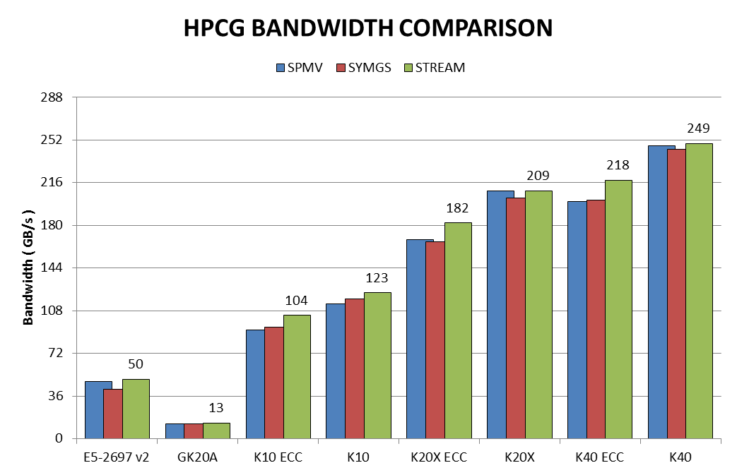
RESULTS – SINGLE GPU

Slide 21
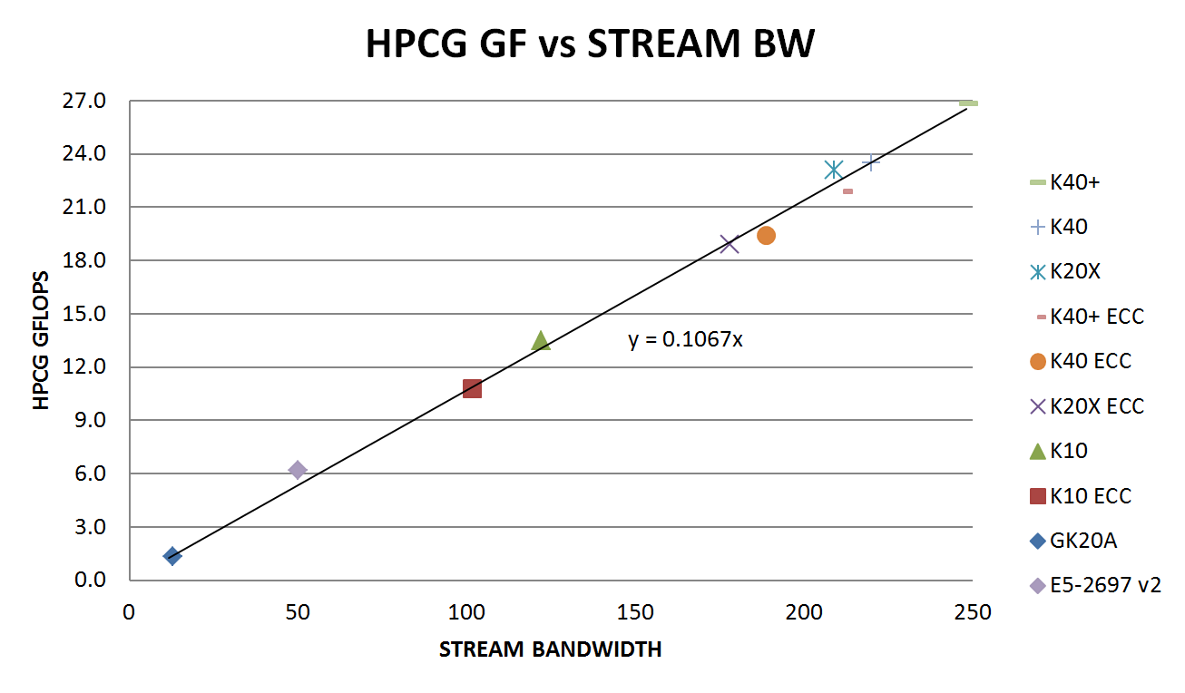
RESULTS – SINGLE GPU

Slide 22
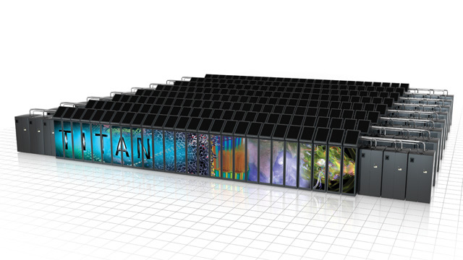
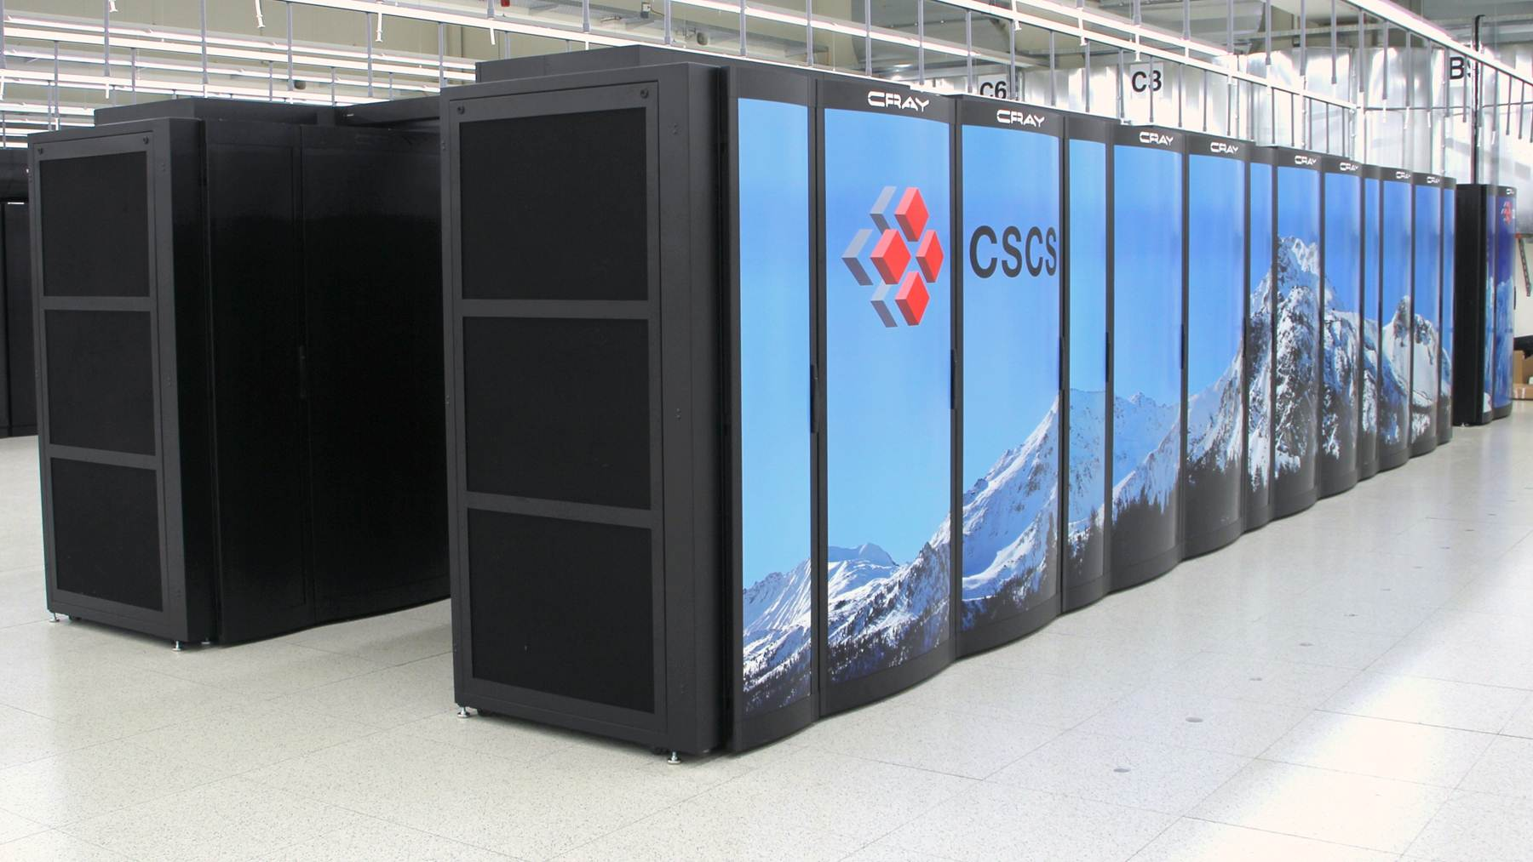
RESULTS – GPU SUPERCOMPUTERS
Titan @ ORNL
Cray XK7, 18688 Nodes
16-core AMD Interlagos + K20X
Gemini Network - 3D Torus Topology
Piz Daint @ CSCS
Cray XC30, 5272 Nodes
8-core Xeon E5 + K20X
Aries Network – Dragonfly Topology

Slide 23
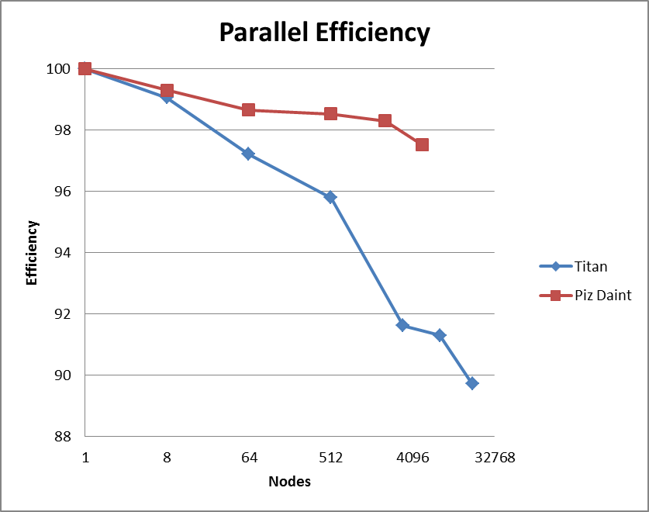
RESULTS – GPU SUPERCOMPUTERS
1 GPU = 20.8 GFLOPS (ECC ON)
~7% iteration overhead at scale
Titan @ ORNL
322 TFLOPS (18648 K20X)
89% efficiency (17.3 GF per GPU)
Piz Daint @ CSCS
97 TFLOPS (5265 K20X)
97% efficiency (19.0 GF per GPU)

Slide 24
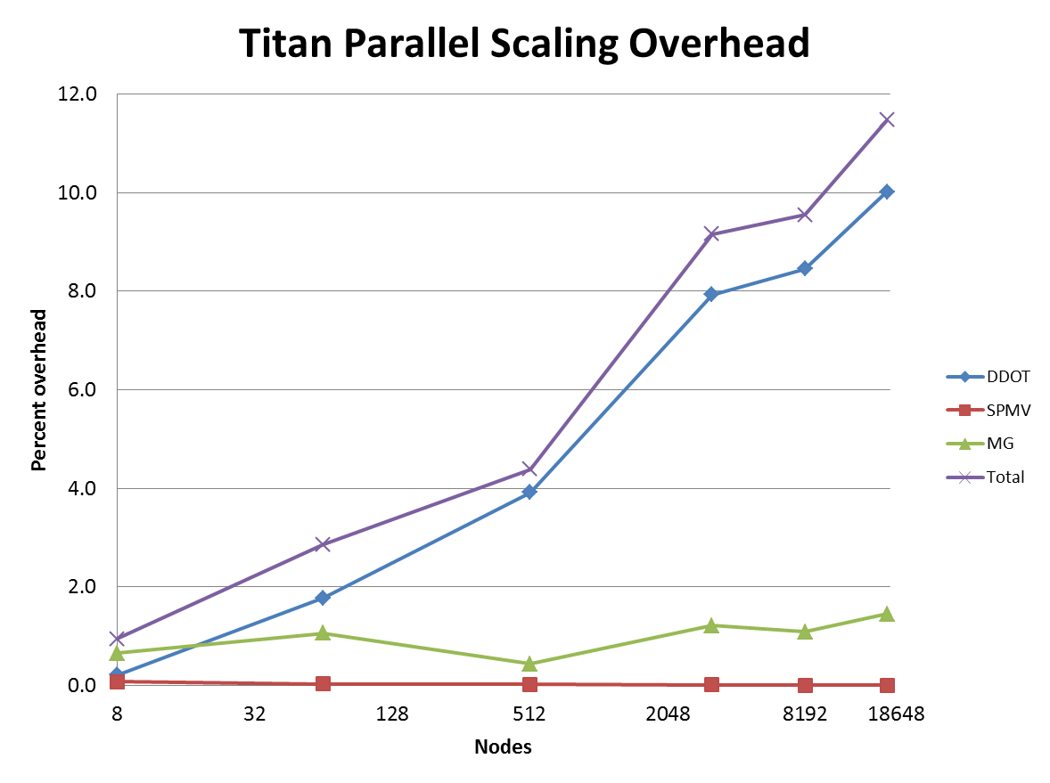
Results – GPU SUPERCOMPUTERS
DDOT (-10%)
MPI_Allreduce()
Scales as Log(#nodes)
MG (-2%)
Exchange Halo (neighbor)
SPMV (-0%)
Overlapped w/Compute

Slide 25
Reproducibility
Residual Variance (reported in output file)
zero = deterministic order of floating point operations
GPU Supercomputers bitwise reproducible up to full scale
except with network hardware-acceleration enabled on Cray XC30
Parallel Dot Product
Local GPU routines bitwise reproducible
MPI_Allreduce()
reproducible with default MPI implementation
Non-reproducible with network offload (hardware atomics)

Slide 26
Reproducibility
CRAY XC30 MPI_Allreduce()
Default → reproducible results but lower performance
Min MPI_Allreduce time: 0.0296645 Max MPI_Allreduce time: 0.153267 Avg MPI_Allreduce time: 0.0916832
MPICH_USE_DMAPP_COL=1
Min DDOT MPI_Allreduce time: 0.0379143 Max DDOT MPI_Allreduce time: 0.0379143 Avg DDOT MPI_Allreduce time: 0.0379143
Residuals: 4.25079640861055e-08 4.25079640861032e-08 4.25079640861079e-08 4.25079640861054e-08

Slide 27
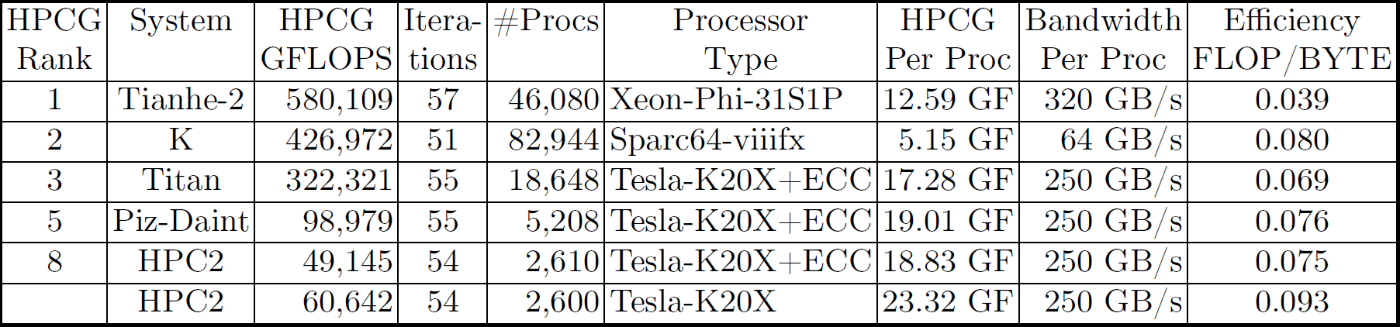
Supercomputer Comparison

Slide 28
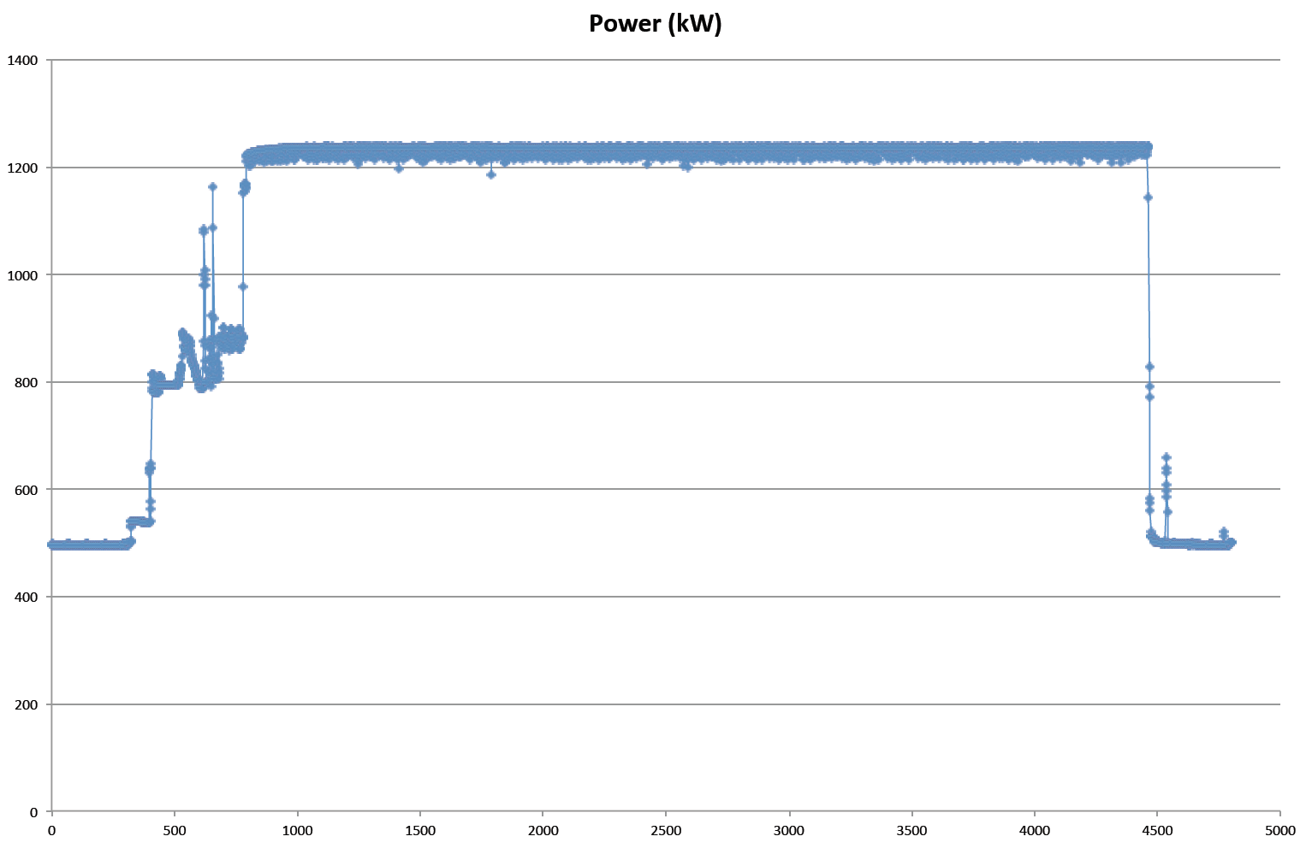
Power Consumption
Piz Daint (5208 K20X)
99 TF / 1232 kW
0.080 GF/W
GK20A (Jetson TK1)
1.4 GF / 8.3 Watts
0.168 GF/W

Slide 29
CONCLUSIONS
GPUs proven effective for HPL, especially for power efficiency
High flop rate
GPUs also very effective for HPCG
High memory bandwidth
Stacked memory will give a huge boost
Future work will add CPU + GPU

Slide 30
Acknowledgments
Oak Ridge Leadership Computing Facility (ORNL)
Buddy Bland, Jack Wells and Don Maxwell
Swiss National Supercomputing Center (CSCS)
Gilles Fourestey and Thomas Schulthess
NVIDIA
Lung Scheng Chien and Jonathan Cohen

